Slide 1
EVELYN WEBSITE
Group Eight(8)
Project

Slide 2
PROJECT OVERVIEW
My team and I was asked to build a website for a restaurant so we decided to build a website called Evelyn which consists of:
Contact.html this consist of form in which consumer or visitors can be able to order.
Gallery.html this consist of images of food and drink
Index.html this consist of the html coding.
Team.html this consist of images and information of group eight members.

Slide 3
PROJECT APPROCH
THE BEGINNING OF THIS PROJECT WAS VERY DIFFICULT BUT AT THE END OF THE DAY WE WERE ABLE TO WORK AS A TEAM TO AND ALSO WITH THE HELP OF YOU TUBE TO GET OUR WORK DONE.

Slide 4
PROJECT CONSTRAINTS
Like I said before, that the beginning of the project was very impossible so in order to get the job done we were forced to commit all of our times and effort.

Slide 5
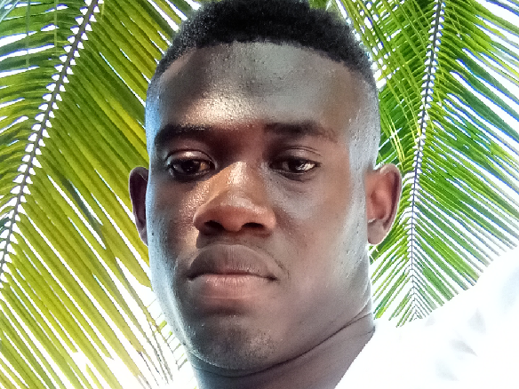
PROJECT FUTURE SCOP
Evelyn website is one of the best restaurant in Liberia right now, but in times to come it will become the number one (1) in the country.

